Slide 1
Web Technologies
Responsive Web Design
Media Queries

Slide 2
Summary of Today’s Lecture
Fixed vs Fluid layouts
Responsive Web Design
Media Queries
Media Types
Media Features
Logical Operators
Identifying Breakpoints
Mobile First Approach
Adding Media Queries
Responsive Web Design Example

Slide 3
CSS Layouts Fixed Vs Fluid
Till CSS2, we can build two types of layouts, Fixed and Fluid.
These layouts are classified as Fixed or Fluid on the basis of their width.
CSS Fixed layouts are layouts with fixed width in px for example, 960px, 1200px, 1170px, etc.
CSS Fluid Layouts or Elastic layouts are layouts with width in percentage.

Slide 4
Fixed Layout
Fixed Layout is a layout in which the width of the container is fixed (in pixels).
Properties of Fixed Layout
Fixed width in pixels.
Independent of screen size.
Horizontal Scroll will come when screen size is less than width of main container.

Slide 5
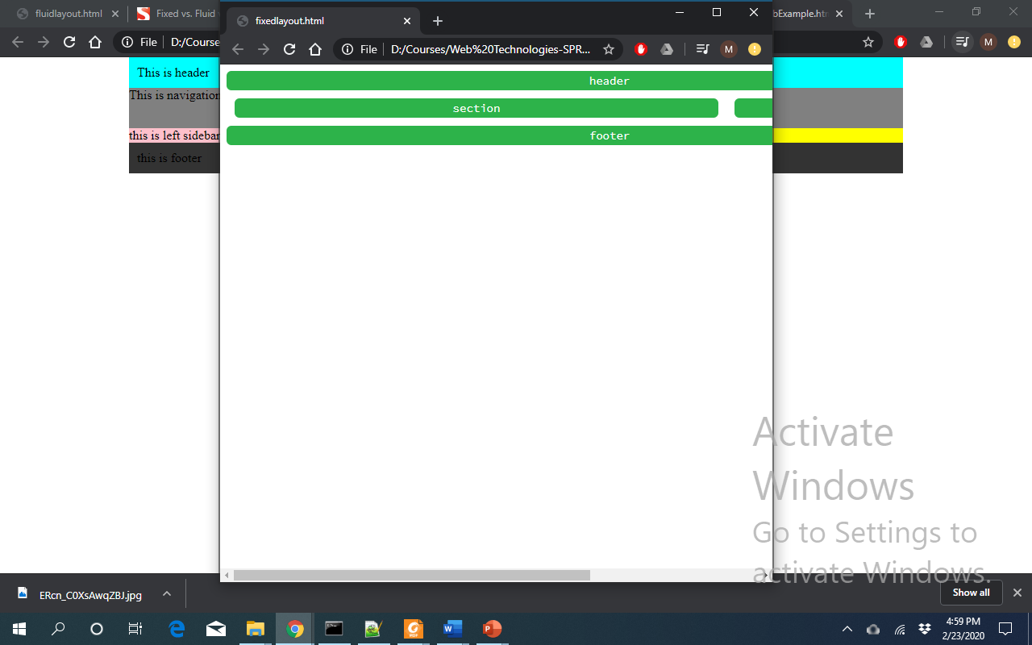
Fixed Layout Example
<main>
<header> header </header>
<div id="container"> <section>section</section>
<aside> Aside </aside>
</div>
<footer>footer</footer>
</main>
header{width: 950px;}
section {
float: left;
width: 600px;
margin:10px;}
aside {
float: left;
width: 300px;
margin:10px;}
footer {
clear: left;
width: 950px;}
main{width:1000px;}
#container{width:1000px;}

Slide 6
Fluid Layouts
Liquid Layouts is a layout in which the width of the container is flexible (in percentage). Whatever the screen-size is, the layout will remain same.
Flexible layouts is the practice of building the layout of a website with a flexible grid, capable of dynamically resizing to any width. (Ethan)
Properties of Fluid Layout
Width is in percentage.
Dependent of screen size.
Horizontal Scroll will Never come on any screen unless any fixed content is inside.

Slide 7
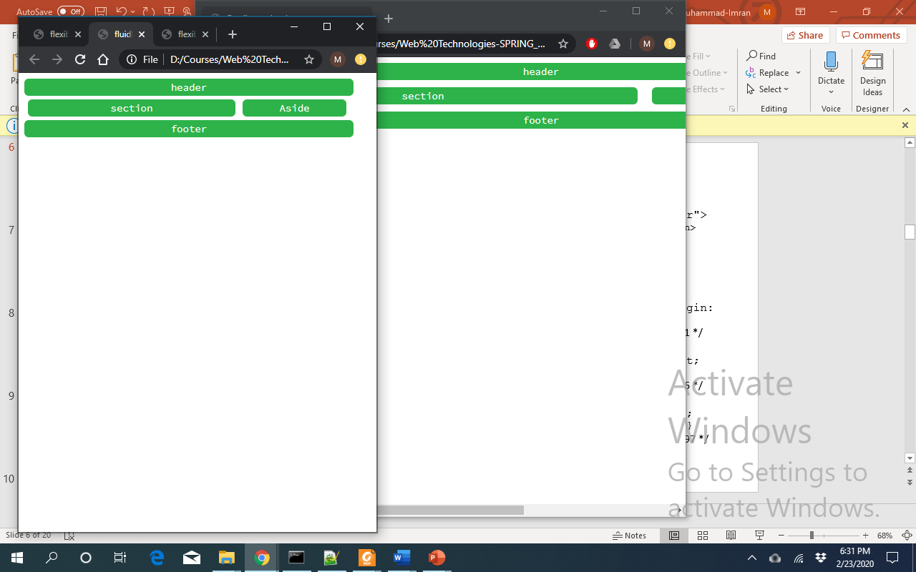
Fluid Layout Example
header{width: 95%;}
section {
float: left;
width: 60%;
margin:1%;}
aside {
float: left;
width: 30%;
margin:1%;}
footer {
clear: left;
width: 95%;}
main{width:100%;}
#container{width:100%;}

Slide 8
Problem with flexible layout
The flexible layout approach alone isn’t enough.
If the width of a browser viewport may be so small that even scaling the layout proportionally will create columns that are too small to effectively display content.
As a result, when the layout gets too small, text may become unreadable and the layout may begin to break.

Slide 9
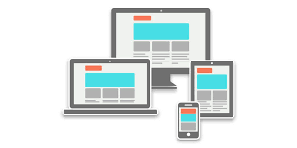
Responsive Web Design (RWD)
Responsive web design is the practice of building a website suitable to work on every device and every screen size, no matter how large or small screes size is.
Responsive web design is focused around providing an intuitive and gratifying experience for everyone.
The responsive web design term itself was coined, and largely developed, by Ethan Marcotte in his book Responsive Web Design in 2010.
Responsive web design can be achieved using media queries which is specified as part of CSS3 specification.

Slide 10
Media Queries
Media queries allow designers to deliver styles based on media type and media features.
Media types reflect target devices for which the relevant properties make sense such as screen, print etc.
Media features specify different styles for individual browser and device circumstances, the width of the viewport or device orientation.
The @media rule, introduced in CSS2, made it possible to define different style rules for different media types.
A media query consists of a media type and can contain one or more media features, which resolve to either true or false.
@media not|only mediatype and (mediafeature and|or|not mediafeature) { CSS-Code; }
For example, following is the media rule that works for all types of media for the size of screen less than 1024px.
@media (max-width: 1024px) {...}
Generally Media queries are added inside of an existing style sheet.

Slide 11
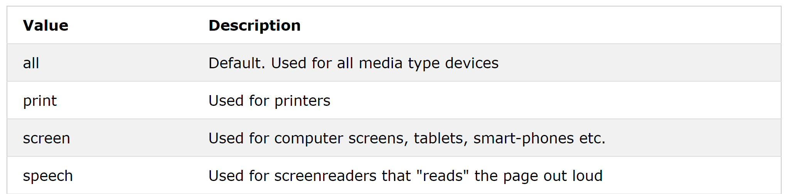
Media Types
Media Types basically define which of the CSS file will be directed for your website based on the type of media, i.e, for each different device that you access a website, you need a different css too.
@media print { ... }
@media screen, print { ... }

Slide 12
Media Features
Media feature uses characteristics to differentiate one device from another device.
Following is the list of media features.
width of the viewport.
height of the viewport.
orientation
Is the tablet/phone in landscape or portrait mode?
aspect-ratio
The aspect-ratio feature is specified as a ratio value representing the width-to-height ratio of the viewport.
resolution
The resolution feature is specified as a <resolution> value representing the pixel density of the output device. It is measured in dpi (dots per inch).
………….

Slide 13
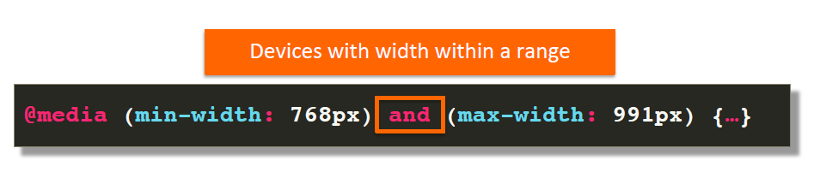
Media Query Logical Operator
The logical operators not, and, and only can be used to compose a complex media query.
You can also combine multiple media queries into a single rule by separating them with commas.
and
The and operator is used for combining multiple media features together into a single media query, requiring each chained feature to return true in order for the query to be true.
It is also used for joining media features with media types.
@media screen and (min-width: 400px) and (max-width: 700px) { … }

Slide 14
not/only logical Operators
not
The not operator is used to negate a media query, returning true if the query would otherwise return false.
If you use the not operator, you must also specify a media type.
@media not (screen and (max-width: 600px)) {……}
only
The only operator is used to apply a style only if an entire query matches.
If you use the only operator, you must also specify a media type.
It is useful for preventing older browsers from applying selected styles.
When not using only, older browsers would interpret the query screen and (max-width: 500px)simply as screen, ignoring the remainder of the query, and applying its styles on all screens.
@media only (screen and (max-width: 500px)) {……}

Slide 15
comma operator
, (comma)
Commas are used to combine multiple media queries into a single rule.
Each query in a comma-separated list is treated separately from the others.
Thus, if any of the queries in a list is true, the entire media statement returns true.
In other words, lists behave like a logical or operator.
For instance, the following rule will apply its styles if the user's device has either a minimum height of 680px or is a screen device in portrait mode:
@media (min-height: 680px), screen and (orientation: portrait) { ... }

Slide 16
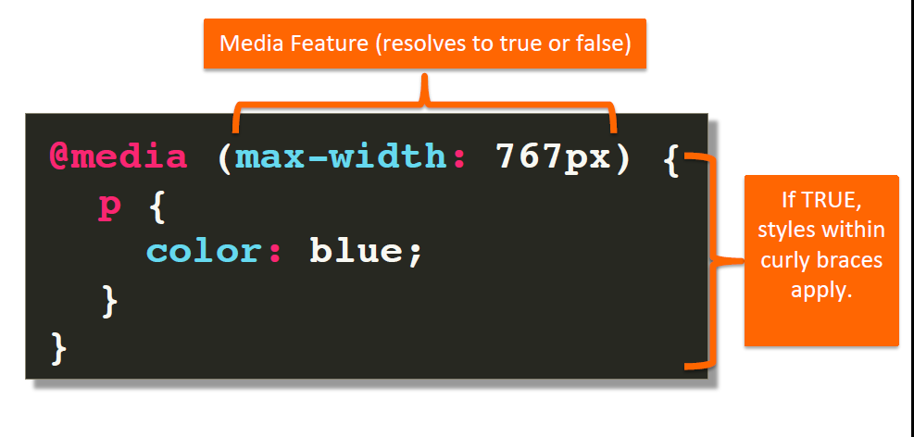
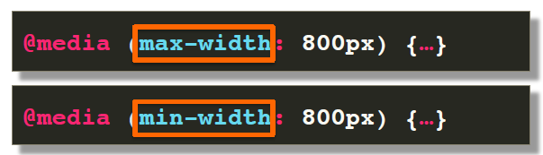
Media Feature (Min and Max Width)
Most properties can be tested for a minimum or maximum value using the min- and max- prefixes, respectively.
The min prefix indicates a value of greater than or equal to while the max prefix indicates a value of less than or equal to.
For example,
max-width: 767px tests whether the display is in the range 0 to 767px.
min-width: 800px tests whether the display is at least 800 pixels wide.

Slide 17
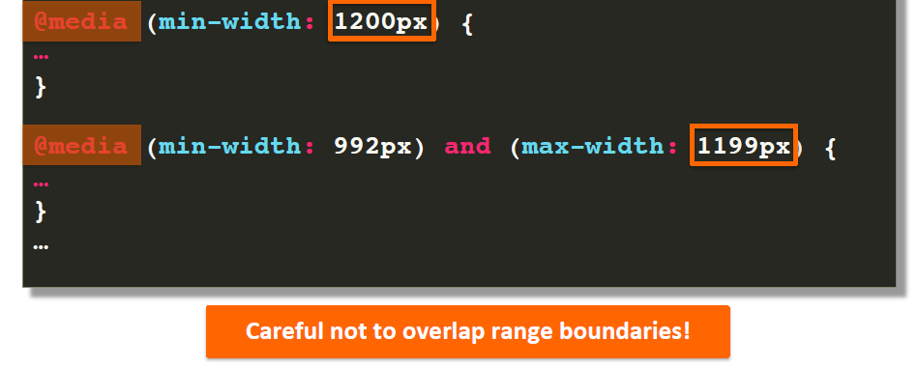
Overlapping?
@media (min-width: 400px) {…}
@media (min-width: 600px) {…}
@media (min-width: 800px) {…}

Slide 18
Media Features (Orientation Syntax)
The ‘orientation’ media feature is ‘portrait’ when the value of the ‘height’ media feature is greater than or equal to the value of the ‘width’ media feature. Otherwise ‘orientation’ is ‘landscape’.
@media all and (orientation:portrait) { … }
@media all and (orientation:landscape) { … }
@media only screen and (orientation: landscape) { body { background-color: lightblue; } }

Slide 19
Media Features (aspect-ratio Syntax)
The aspect-ratio feature is specified as a <ratio> value representing the width-to-height aspect ratio of the viewport.
/* Minimum aspect ratio */
@media (min-aspect-ratio: 8/5) {
div {background: #9af; /* blue */ }
}
/* Maximum aspect ratio */
@media (max-aspect-ratio: 3/2) {
div {background: #9ff; /* cyan */ }
}

Slide 20
Complex Media Queries
@media only (screen and (min-width: 100px)),
not (screen and (min-width: 100px)),
not (print and (min-height: 100px)),
(min-height: 100px) and (max-height: 1000px),
(orientation: landscape)
{ p
{ background: red; }
}

Slide 21


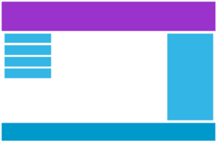
Identifying Breakpoints
The point at which the media query delivers a new set of styles is known as a breakpoint.
Some sites have just two layouts triggered at a single breakpoint. More commonly, responsive sites use three designs targeted at typical phone, tablet and desktop widths.
How many you choose depends on the nature of your site’s design.

Slide 22
Mobile First Approach
One popular technique with using media queries is called mobile first.
The mobile first approach includes using styles targeted at smaller viewports as the default styles for a website, then use media queries to add styles as the viewport grows.
The operating belief behind mobile first design is that a user on a mobile device, commonly using a smaller viewport, shouldn’t have to load the styles for a desktop computer only to have them overwritten with mobile styles later.
/* Default styles first then media queries */
@media (min-width: 400px and max-width: 599px) {...}
@media (min-width: 600px and max-width: 999px) {...}
@media (min-width: 1000px and max-width: 1399px) {...}
@media (min-width: 1400px) {...}

Slide 23
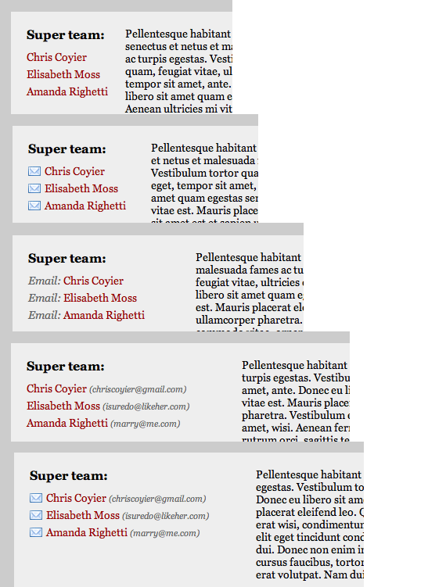
Mobile First Approach

Slide 24
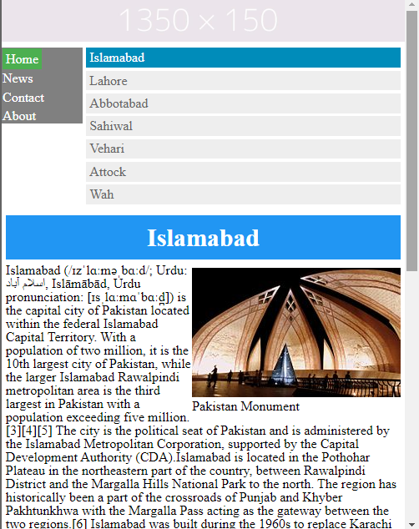
Small Viewport

Slide 25
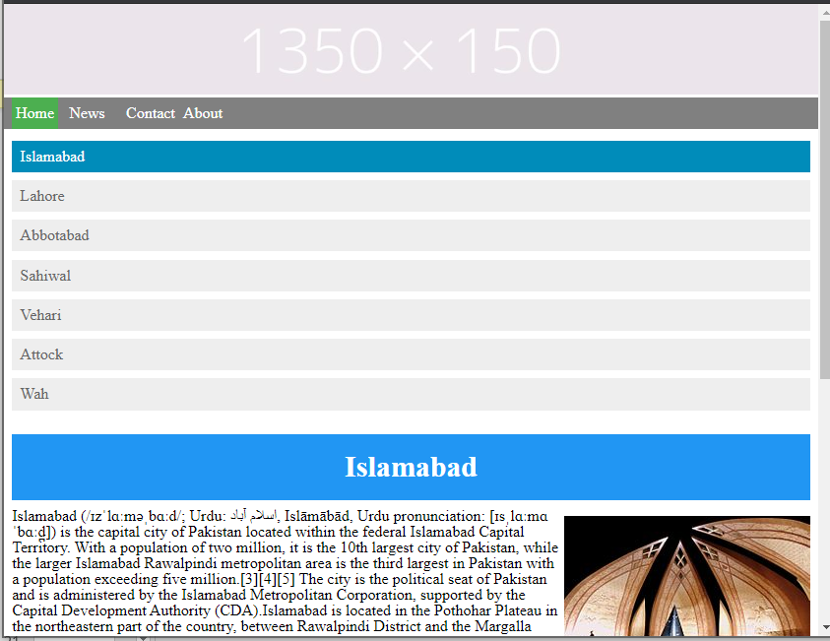
Medium Viewport

Slide 26
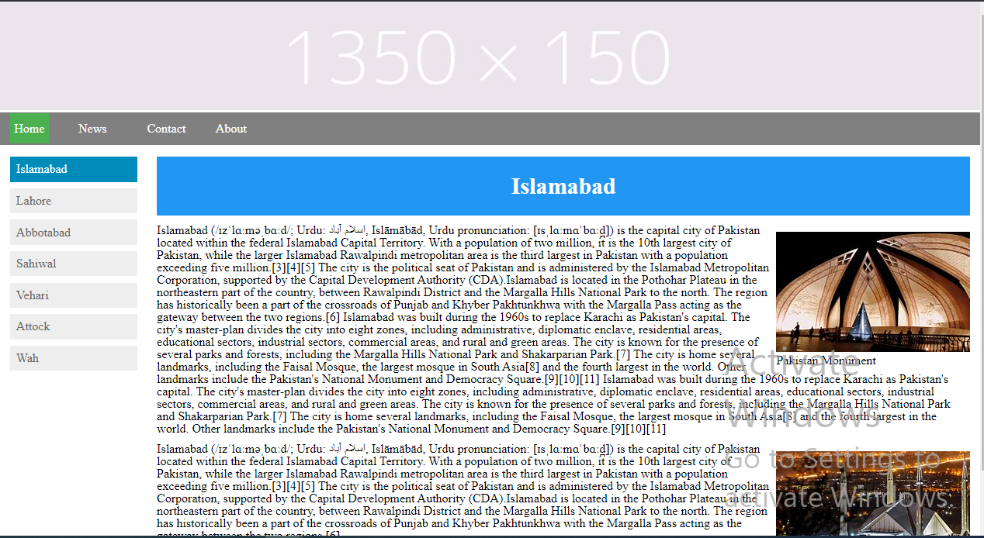
Big Viewport

Slide 27
Linking Stylesheets
Multiple CSS stylesheets can be linked within HTML. There are two main approaches:
@import CSS rule.
<link> element.

Slide 28
@import CSS Rule
The @import CSS rule is used to import style rules from other style sheets. These rules must precede all other types of rules.
@import url(“style1.css")
@import url(“style2.css")
……
When importing multiple CSS files, the styles are applied in the order that they are imported in the HTML document.
In the above code, all the rules from style1.css would be applied first, then the rules from style2.css will be applied. This can cause similar rules to overwrite the rules from the previously imported files.

Slide 29
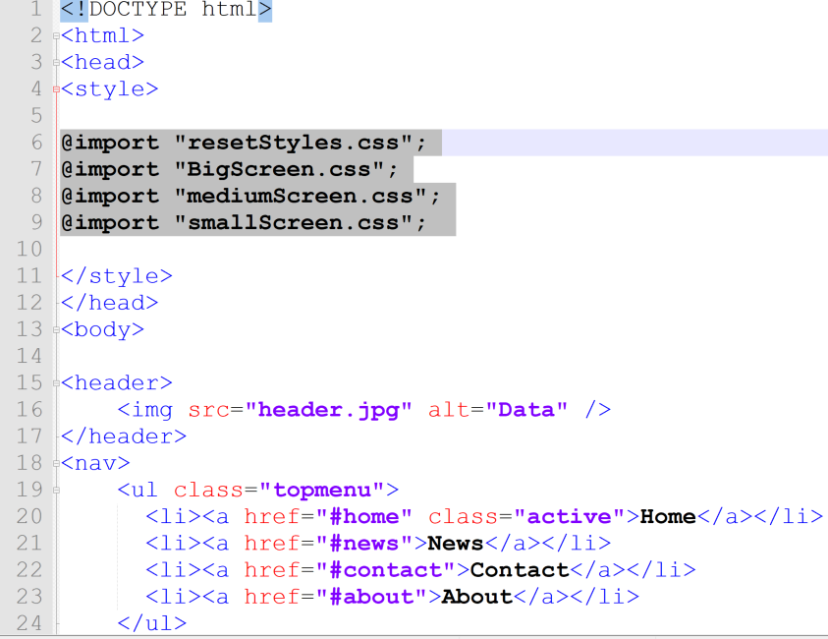
@import CSS Rule

Slide 30
<link> element
<link> element can be used to link multiple stylesheets in a single HTML file.
For each stylesheet you link to a page, you would just need to add an additional <link> element.
<link href="style1.css" rel="stylesheet">
<link href="style2.css" rel="stylesheet">
...
When linking multiple CSS files, the styles are applied in the order that they are linked in the HTML document.
In the above code, all the rules from style1.css would be applied first, then the rules from style2.css will be applied. This can cause similar rules to overwrite the rules from the previously linked files.

Slide 31
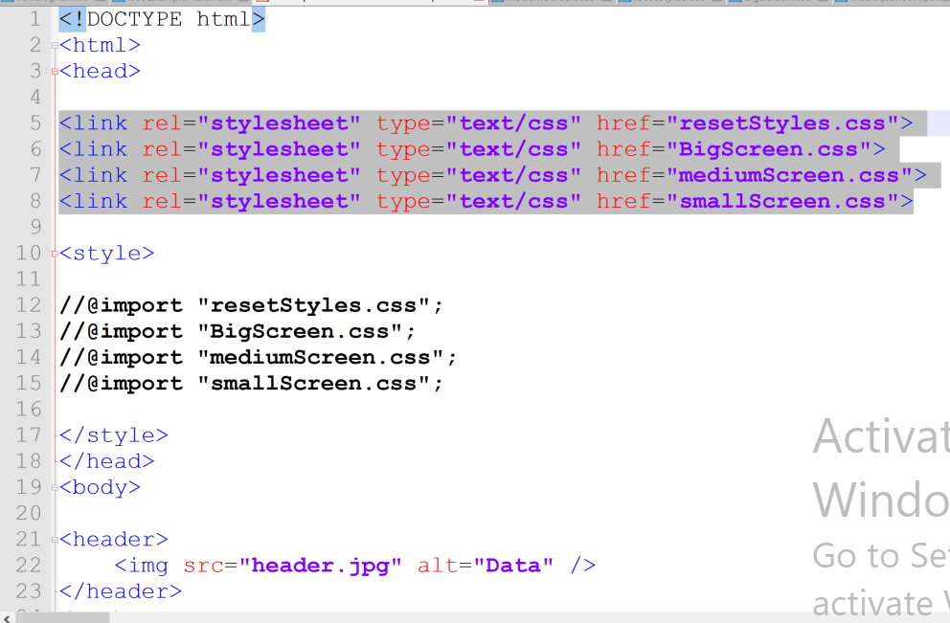
<link> element Example

Slide 32
Summary of Today’s Lecture
Fixed vs Fluid layouts
Responsive Web Design
Media Queries
Media Types
Media Features
Logical Operators
Identifying Breakpoints
Mobile First Approach
Adding Media Queries
Responsive Web Design Example

Slide 33
Resources
Responsive Web Design by Ethan Marcotte
https://www.w3.org/TR/css3-mediaqueries/
https://abookapart.com/products/responsive-web-design
http://learn.shayhowe.com/advanced-html-css/responsive-web-design/
https://www.w3schools.com/cssref/pr_import_rule.asp
https://developer.mozilla.org/en-US/docs/Web/CSS/@import
https://discuss.codecademy.com/t/can-you-apply-multiple-stylesheets-to-a-single-page/369792

